Slide 1
STA/BST 222 Survival Analysis Lecture 7
Lihong Qi
Division of Biostatistics
Department of Public Health Sciences
School of Medicine
Oct. 22, 2020

Slide 2
How to contact me
Email is best: lhqi@ucdavis.edu
Phone: 530-754-9234
Office hour: email for an appointment

Slide 3
How to contact TA
Xiner Zhou
Email: xezhou@ucdavis.edu
Office hours: 7:00pm – 8:00pm, Thursdays
Lab: 6:10-7:00 pm, Thursdays
For both Lab and OH, please use the zoom link with passcode: survival https://ucdstats.zoom.us/j/9681353237?pwd=ZzhLRHlhNG92bHFUaHkwM0Fib1pqQT09 Meeting ID: 968 135 3237

Slide 4
Focus
Kaplan-Meier Estimator (Kaplan, EL and Meier, P. JASA 1958: 457-481)

Slide 5
Introduction
Non-parametric estimate of survivor function.
Commonly used to describe survivorship of study populations.
Commonly used to compare two study populations.
Also known as product limit estimator
Intuitive graphical presentation.

Slide 6
Some useful terms
Assume D distinct event times, i.e. t₁<t₂<…<t_{D}
Number of subjects at risk at : Y_{j}, j=1,…D
The number of subjects alive at or experience an event at
Number of subjects who died at
Notation: d_{j}, j=1,…D
d_{j} /Y_{j} : an estimate of the conditional probability that an individual who survives to just prior to time experiences the event at time
Proportion surviving (remaining event free): 1- d_{j} /Y_{j}

Slide 7
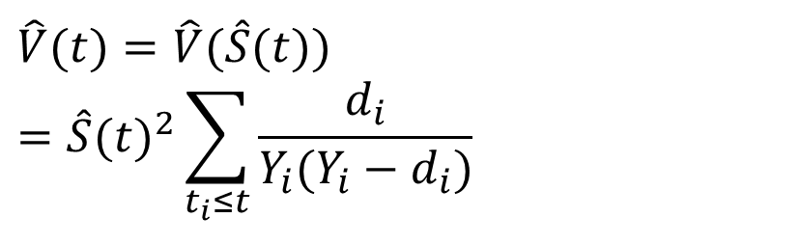
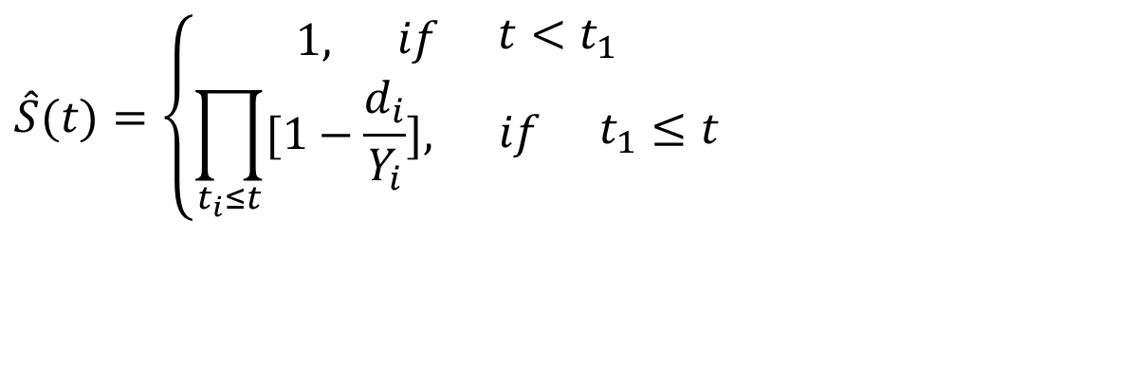
KM estimator
$$\hat{S}(t)=\left\{\begin{matrix}1,\begin{matrix} & if\begin{matrix} & t<t_{1}\end{matrix}\end{matrix} \\ \prod_{t_{i}≤t}{[1−\frac{d_{i}}{Y_{i}}],\begin{matrix} & if\begin{matrix} & t_{1}≤t\end{matrix}\end{matrix}}\end{matrix}\right.$$
Greenwood’s formula for variance
$$\hat{V}(t)=\hat{V}(\hat{S}(t))=\hat{S}(t)^{2}\sum_{t_{i}≤t}{\frac{d_{i}}{Y_{i}(Y_{i}−d_{i})}}$$

Slide 8
Survival Data (right-censored)
Subject A
Subject B
Subject C
Subject D
Subject E
X
1. subject E dies at 4 months
Beginning of study
End of study
→ Time in months →

Slide 9
Corresponding Kaplan-Meier Curve
100%
Probability of surviving to just before 4 months is 100% = 5/5
Fraction surviving this death = 4/5
Subject E dies at 4 months
→ Time in months →

Slide 10
Survival Data
Subject A
2. subject A drops out after 6 months
Subject B
Subject C
3. subject C dies at 7 months
X
Subject D
Subject E
X
1. subject E dies at 4 months
Beginning of study
End of study
→ Time in months →

Slide 12
Survival Data
Subject A
2. subject A drops out after 6 months
Subject B
4. Subjects B and D survive for the whole year-long study period
Subject C
3. subject C dies at 7 months
X
Subject D
Subject E
X
1. subject E dies at 4 months
Beginning of study
End of study
→ Time in months →

Slide 14
The product limit estimate
The probability of surviving in the entire year, taking into account censoring
S(1 year)= (4/5) (2/3) = 53%
NOTE: > 40% (2/5) because the one drop-out survived at least a portion of the year.
AND <60% (3/5) because we don’t know if the one drop-out would have survived until the end of the year.

Slide 15
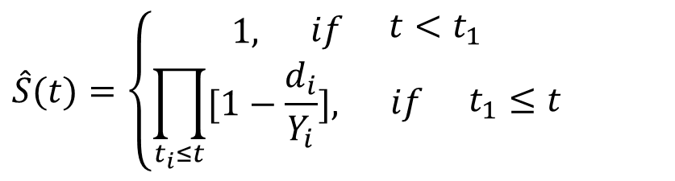
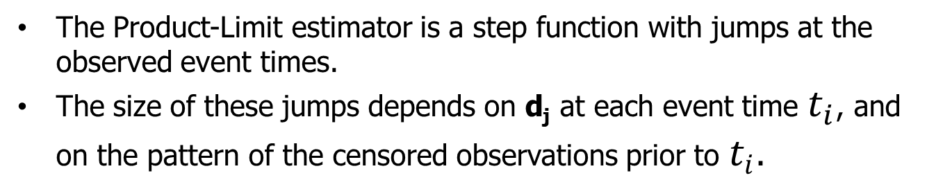
KM estimator
$$\hat{S}(t)=\left\{\begin{matrix}1,\begin{matrix} & if\begin{matrix} & t<t_{1}\end{matrix}\end{matrix} \\ \prod_{t_{i}≤t}{[1−\frac{d_{i}}{Y_{i}}],\begin{matrix} & if\begin{matrix} & t_{1}≤t\end{matrix}\end{matrix}}\end{matrix}\right.$$
Greenwood’s formula
The Product-Limit estimator is a step function with jumps at the observed event times.
The size of these jumps depends on d_{j} at each event time $t_{i}$, and on the pattern of the censored observations prior to $t_{i}.$

Slide 16
KM 1.2: Effect of 6-MP on children with acute leukemia
A randomized clinical trial: a drug 6-mercaptopurine (6-MP) vs a placebo.
42 patients were 1-1 matched by their remission status: a complete or partial remission
Patients were followed until their leukemia returned (relapse) or until the end of the study (in months)
Event of interest
Remission
Time
Time from randomization to remission or to censoring

Slide 17
KM 1.2: Clinical Trial for Acute Leukemia
Let’s only consider the 6MP group
7 distinct event times
6, 7, 10, 13, 16, 22, 23
d: 3, 1, 1, 1, 1, 1, 1
Y: 21, 17, 15, 12, 11, 7, 6
S(t)=?
V(t)=?

Slide 18
Construction, Table 4.1a

Slide 19
KM estimator and its estimated SE, Table 4.1a

Slide 20
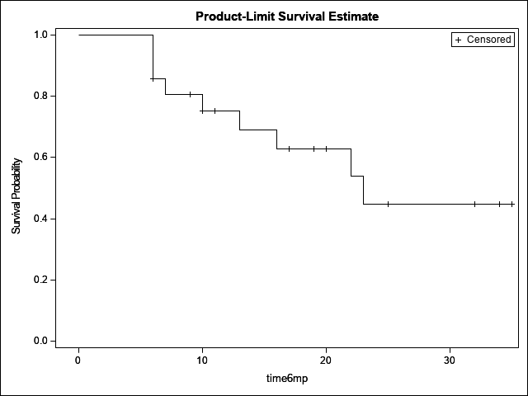
KM 1.2: Kaplan-Meier curve (6-MP)
Note: the survival curve is defined only up to 35 weeks, the largest of the observation times.

Slide 21
KM estimator for H(t)
The product limit estimator can also be used
to estimate the cumulative hazard function
H(t ) = ln[S (t )]:

Slide 22
The Nelson-Aalen estimator for H(t)
The NA estimator
Estimated variance of the NA estimator

Slide 23
The Nelson-Aalen estimator for H(t)
First suggested by Nelson (1972) in a reliability context and rediscovered by Aalen (1978).
The Nelson-Aalen (NA) estimator has better small-sample-size performance than the estimator based on the KM estimator.

Slide 24
NA Estimator for S(t)
Nelson Aalen (NA) estimator
Recall S(t)=e^{-H(t)}

Slide 25
Assumptions
KM and NA estimators do NOT specify distributional forms for survival functions.
Assume noninformative censoring: meaning knowledge of a censoring time for an individual provides no further information about this person’s likelihood of survival at a future time had the individual continued on the study

Slide 26
Kaplan-Meier vs. Nelson Aalen
Prefer KM to estimate S(t) and NA to estimate H(t)
S_{KM}(t)≤S_{NA}(t)
For continuous distributions, they are asymptotically equivalent.
Observe greater difference at the tail of the survival curve.

Slide 27
KM 1.2: KM vs. NA (6-MP)
Obs time6mp SKM SNA HKM HNA
1 0.0000 1.00000 1.00000 0.00000 0.00000
2 6.0000 . . . .
3 6.0000 . . . .
4 6.0000 0.85714 0.86688 0.15415 0.14286
5 6.0000 . . . .
6 7.0000 0.80672 0.81736 0.21478 0.20168
7 9.0000 . . . .
8 10.0000 0.75294 0.76464 0.28377 0.26835
9 10.0000 . . . .
10 11.0000 . . . .
11 13.0000 0.69020 0.70350 0.37078 0.35168
12 16.0000 0.62745 0.64237 0.46609 0.44259
13 17.0000 . . . .
14 19.0000 . . . .
15 20.0000 . . . .
16 22.0000 0.53782 0.55686 0.62024 0.58545
17 23.0000 0.44818 0.47137 0.80256 0.75211
18 25.0000 . . . .
19 32.0000 . . . .
20 32.0000 . . . .
21 34.0000 . . . .
22 35.0000 . . . .

Slide 28
S(t): KM vs. Nelson-Aalen

Slide 29
H(t): KM vs. Nelson-Aalen

Slide 30
Alternative Standard Error Estimator

Slide 31
Properties of KM and NA estimators
Under certain regularity conditions
KM and NA are nonparametric maximum likelihood and consistent estimator (NMLE) for S(t) and H(t), respectively.
NA for H(t) is the 1st term in a Taylor series expansion of –log(KM).
Under regularity conditions, both KM and NA converge weakly to Gaussian processes.
For fixed t, KM and NA have an approximate normal distribution.

Slide 32
Issues associated with KM estimator
KM is only well defined up to the largest event time point t_{max} when the largest time point is censored.
If the largest study time corresponds to a death time, then, the estimated survival curve is zero beyond this point.
If the largest time point is censored, the value of S (t ) beyond this point is undetermined because we do not know when this last survivor would have died if the survivor had not been censored.
How to estimate S(t) when t is greater than t_{max}?
Please read the practical notes in the textbook KM.

Slide 33
Homework 2
Reading: KM 4.1, 4.2
Other: as assigned before

